Slide 1
Week 11 Assignment
Inferential Statistics
By
Abdullahi Adamu
FE/23/24941390

Slide 2
About the Dataset
Life expectancy at birth indicates the number of years a newborn infant would live if prevailing patterns of mortality at the time of its birth were to stay the same throughout its life. It is a key metric for assessing population health.
Life expectancy has multiplied since the advent of industrialization in the early 1900s and the world average has now more than doubled to 70 years. Yet, we still see inequality in life expectancy across and within countries. The study by Acemoglu and Johnson demonstrated the relationship between increased life expectancy and improvement in economic growth (GDP per capita), controlling for country-fixed effects.

Slide 3
Methodology
Correlation coefficient was used to determine the relationship between the Number of sanitations and Cases of Communicable diseases

Slide 4
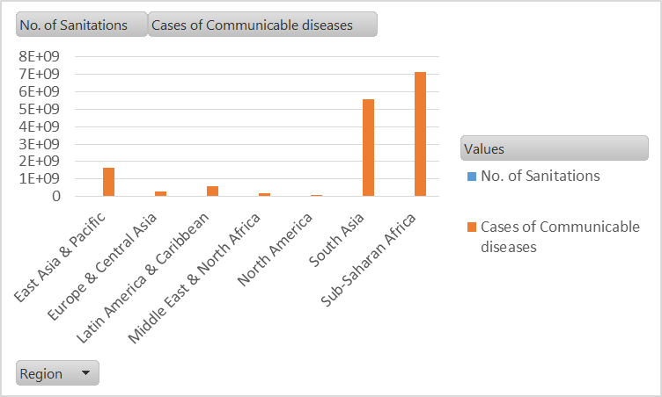
Result: Number of sanitations and cases of communicalbel diseases

Slide 5
Result …..
Region | No. of Sanitations | Cases of Communicable diseases | Correlation
East Asia & Pacific | 264 | 1663756138 | 0.78
Europe & Central Asia | 792 | 268685720.5
Latin America & Caribbean | 263 | 585194340.4
Middle East & North Africa | 284 | 170750601.3
North America | 38 | 102949716
South Asia | 76 | 5581107926
Sub-Saharan Africa | 342 | 7120425807
Grand Total | 2059 | 15492870250
Results shows a significant relationship between number of sanitations and cases of communicable disease with coefficient correlation of 0.78.

Slide 6
Conclusion
From the data analysis of this dataset, Poor environmental sanitation results in high number of communicable diseases.

Slide 7
Recommendation
Countries in the Sub-Saharan Africa should improve their level of sanitation so as to reduce the number of cases of communicable diseases.

